Slide 1
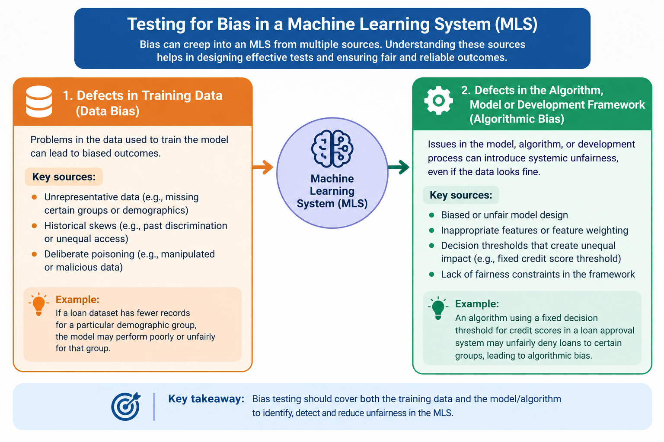
5.1.2 Testing for Bias

Slide 2
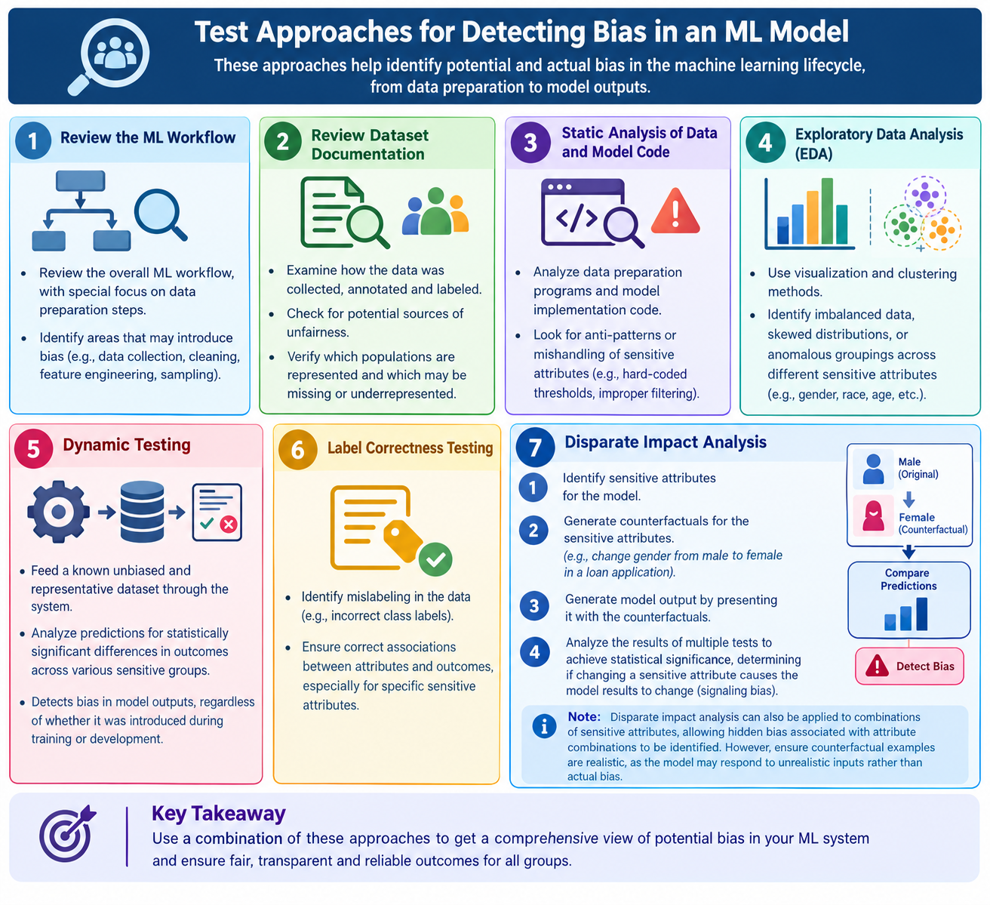
5.1.2 Testing for Bias

Slide 3
5.1.2 Testing for Bias
Test Approaches for Detecting Bias
The following testing approaches can be used to identify bias in Machine Learning Systems.
Review of the ML Workflow
Review the complete machine learning workflow, particularly the data preparation process, to identify activities that may introduce bias into the system.
2. Review of Dataset Documentation
Examine dataset documentation to understand how the data was collected, annotated, and prepared. Check whether different population groups are adequately represented and identify potential sources of unfairness.

Slide 4
5.1.2 Testing for Bias
3. Static Analysis
Perform static analysis of data preparation programs and model implementation code to identify coding anti-patterns, incorrect data handling, or improper use of sensitive attributes that may introduce bias.
4. Exploratory Data Analysis (EDA)
Use data visualization and clustering techniques to analyze training datasets. These techniques help identify imbalanced data, skewed distributions, and unusual groupings associated with sensitive attributes such as gender, age, or race.
5. Dynamic Testing
Dynamic testing helps detect bias by providing the ML model with a known, unbiased, and representative dataset.
The model's predictions are then analyzed to identify statistically significant differences in outcomes across sensitive groups. This approach helps detect bias in model outputs, regardless of whether it originated from training data or model development.

Slide 5
5.1.2 Testing for Bias
6. Label Correctness Testing
Label correctness testing is performed to identify incorrectly labeled training data that may cause the ML model to learn incorrect relationships between sensitive attributes and predicted outcomes.
For example, incorrect labels in a recruitment dataset may cause a model to associate a particular gender with lower job suitability.

Slide 6
5.1.2 Testing for Bias
7. Disparate Impact Analysis
Disparate impact analysis evaluates whether a Machine Learning System produces unfairly different outcomes for different sensitive groups.
The testing process involves the following steps:
Identify Sensitive Attributes: Determine which sensitive attributes, such as gender, age, or race, may influence the model's predictions.
2. Generate Counterfactuals: Create alternative test scenarios by changing a sensitive attribute while keeping other relevant attributes unchanged. For example, change the gender of a loan applicant from male to female while keeping income, credit score, and employment details the same.
3. Generate Model Outputs: Provide the original and counterfactual test scenarios to the ML model and record the predictions.
4. Analyze the Results: Compare the model's outputs across multiple test cases to determine whether changes in sensitive attrib

Slide 7
5.1.2 Testing for Bias
Important Note
Disparate impact analysis can also be applied to combinations of sensitive attributes, such as gender and age, to identify hidden bias that may not be visible when attributes are evaluated individually.
However, counterfactual test scenarios must be realistic. Unrealistic combinations of attributes may cause the model to produce different results because of unusual input data rather than actual bias.
Key takeaway: Testing for bias helps ensure that Machine Learning Systems produce fair and consistent outcomes across different population groups. It involves examining training data, algorithms, implementation code, and model predictions to detect potential discrimination.
Terminology note: Counterfactual testing is particularly useful for assessing whether changing a sensitive attribute affects a prediction. Traditional disparate impact analysis generally compares outcome rates between groups, without necessarily changing individual attributes.

Slide 8
THANK YOU!!!

